Slide 1
Linear Model Selection and regularization
Chapter 06

Slide 2
Outline
Subset Selection
  Best Subset Selection
  Stepwise Selection
  Choosing the Optimal Model
Shrinkage Methods
  Ridge Regression
  The Lasso

Slide 3
Improving on the Least Squares Regression Estimates?
We want to improve the Linear Regression model, by replacing the least square fitting with some alternative fitting procedure, i.e., the values that minimize the mean square error (MSE)
There are 2 reasons we might not prefer to just use the ordinary least squares (OLS) estimates
  Prediction Accuracy
  Model Interpretability

Slide 4
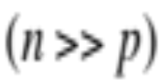


1. Prediction Accuracy
The least squares estimates have relatively low bias and low variability especially when the relationship between Y and X is linear and the number of observations n is way bigger than the number of predictors p
But, when , then the least squares fit can have high variance and may result in over fitting and poor estimates on unseen observations,
And, when , then the variability of the least squares fit increases dramatically, and the variance of these estimates in infinite

Slide 5
2. Model Interpretability
When we have a large number of variables X in the model there will generally be many that have little or no effect on Y
Leaving these variables in the model makes it harder to see the “big picture”, i.e., the effect of the “important variables”
The model would be easier to interpret by removing (i.e. setting the coefficients to zero) the unimportant variables

Slide 6
Solution
Subset Selection
  Identifying a subset of all p predictors X that we believe to be related to the response Y, and then fitting the model using this subset
  E.g. best subset selection and stepwise selection
Shrinkage
  Involves shrinking the estimates coefficients towards zero
  This shrinkage reduces the variance
  Some of the coefficients may shrink to exactly zero, and hence shrinkage methods can also perform variable selection
  E.g. Ridge regression and the Lasso
Dimension Reduction
  Involves projecting all p predictors into an M-dimensional space where M < p, and then fitting linear regression model
  E.g. Principle Components Regression

Slide 7
6.1 Subset selection

Slide 8
6.6.1 Best Subset Selection
In this approach, we run a linear regression for each possible combination of the X predictors
How do we judge which subset is the “best”?
One simple approach is to take the subset with the smallest RSS or the largest R²
Unfortunately, one can show that the model that includes all the variables will always have the largest R² (and smallest RSS)

Slide 9
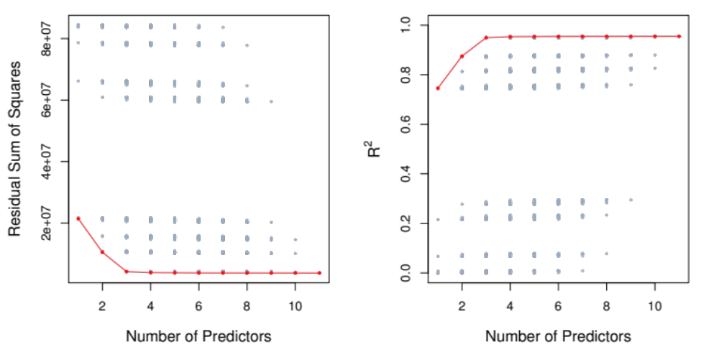
Credit Data: R² vs. Subset Size
The RSS/R² will always decline/increase as the number of variables increase so they are not very useful
The red line tracks the best model for a given number of predictors, according to RSS and R²

Slide 10
Other Measures of Comparison
To compare different models, we can use other approaches:
  Adjusted R²
  AIC (Akaike information criterion)
  BIC (Bayesian information criterion)
  C_{p} (equivalent to AIC for linear regression)
These methods add penalty to RSS for the number of variables (i.e. complexity) in the model
None are perfect

Slide 11
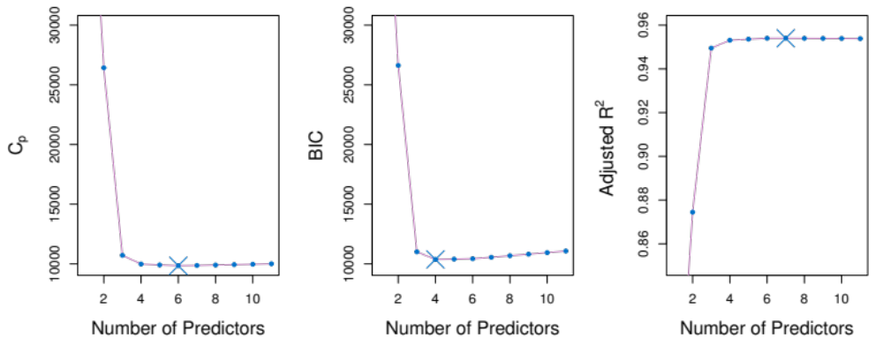
Credit Data: C_{p}, BIC, and Adjusted R²
A small value of C_{p} and BIC indicates a low error, and thus a better model
A large value for the Adjusted R² indicates a better model

Slide 12
6.1.2 Stepwise Selection
Best Subset Selection is computationally intensive especially when we have a large number of predictors (large p)
More attractive methods:
  Forward Stepwise Selection: Begins with the model containing no predictor, and then adds one predictor at a time that improves the model the most until no further improvement is possible
  Backward Stepwise Selection: Begins with the model containing all predictors, and then deleting one predictor at a time that improves the model the most until no further improvement is possible

Slide 13
6.2 Shrinkage Methods

Slide 14
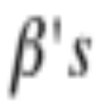
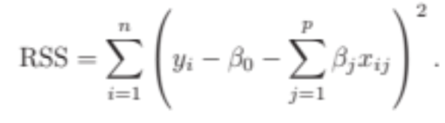
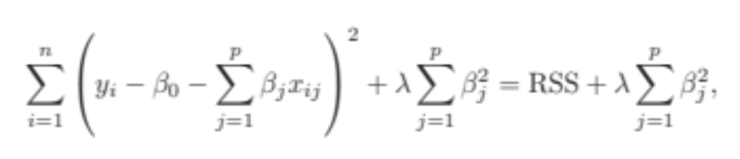
6.2.1 Ridge Regression
Ordinary Least Squares (OLS) estimates by minimizing
Ridge Regression uses a slightly different equation

Slide 15
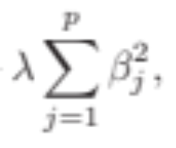

Ridge Regression Adds a Penalty on !
The effect of this equation is to add a penalty of the form
Where the tuning parameter is a positive value.
This has the effect of “shrinking” large values of towards zero.
It turns out that such a constraint should improve the fit, because shrinking the coefficients can significantly reduce their variance
Notice that when = 0, we get the OLS!

Slide 16
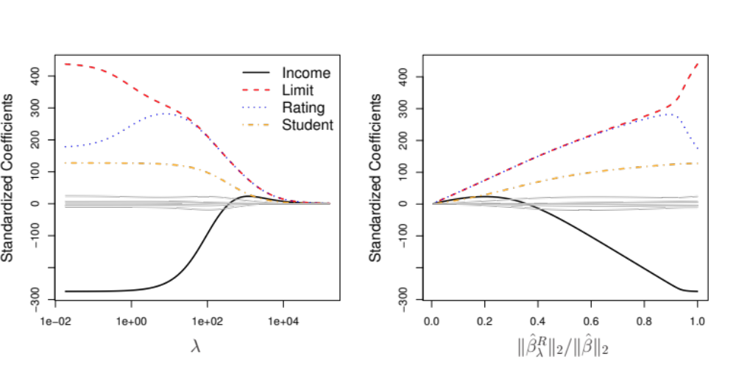
Credit Data: Ridge Regression
As increases, the standardized coefficients shrinks towards zero.

Slide 17
Why can shrinking towards zero be a good thing to do?
It turns out that the OLS estimates generally have low bias but can be highly variable. In particular when n and p are of similar size or when n < p, then the OLS estimates will be extremely variable
The penalty term makes the ridge regression estimates biased but can also substantially reduce variance
Thus, there is a bias/ variance trade-off

Slide 18
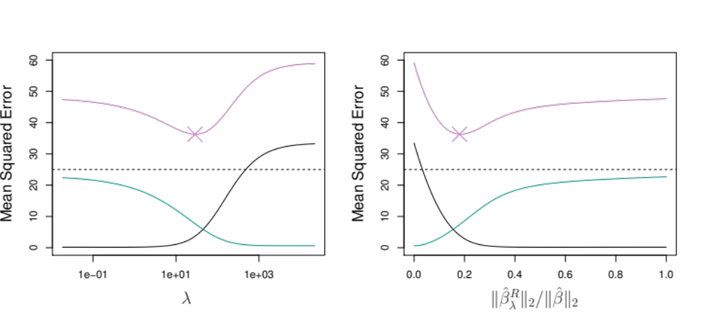
Ridge Regression Bias/ Variance
Black: Bias
Green: Variance
Purple: MSE
Increase increases bias but decreases variance

Slide 19
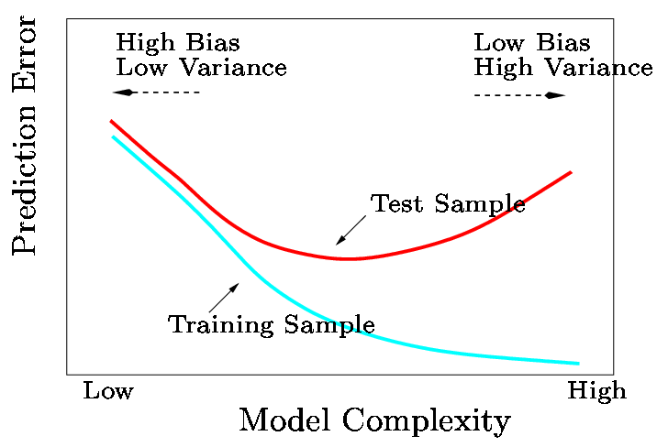
Bias/ Variance Trade-off
In general, the ridge regression estimates will be more biased than the OLS ones but have lower variance
Ridge regression will work best in situations where the OLS estimates have high variance

Slide 20
Computational Advantages of Ridge Regression
If p is large, then using the best subset selection approach requires searching through enormous numbers of possible models
With Ridge Regression, for any given , we only need to fit one model and the computations turn out to be very simple
Ridge Regression can even be used when p > n, a situation where OLS fails completely!

Slide 21
6.2.2. The LASSO
Ridge Regression isn’t perfect
One significant problem is that the penalty term will never force any of the coefficients to be exactly zero. Thus, the final model will include all variables, which makes it harder to interpret
A more modern alternative is the LASSO
The LASSO works in a similar way to Ridge Regression, except it uses a different penalty term

Slide 22
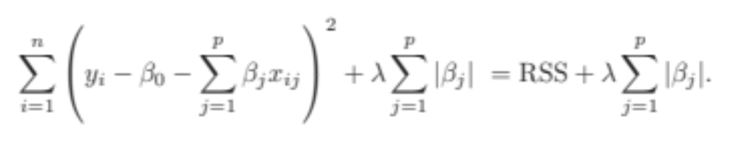
LASSO’s Penalty Term
Ridge Regression minimizes
The LASSO estimates the by minimizing the

Slide 23
What’s the Big Deal?
This seems like a very similar idea but there is a big difference
Using this penalty, it could be proven mathematically that some coefficients end up being set to exactly zero
With LASSO, we can produce a model that has high predictive power and it is simple to interpret

Slide 24
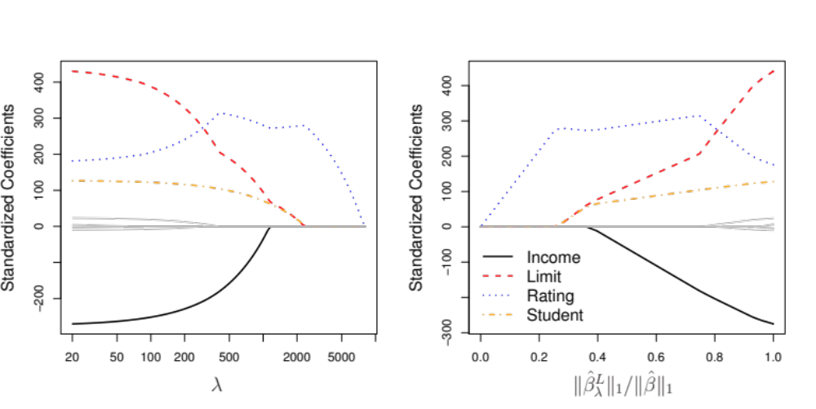
Credit Data: LASSO

Slide 25
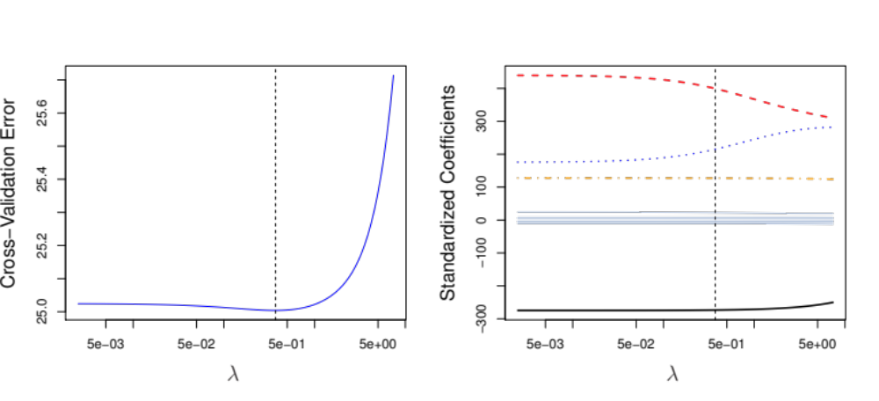
6.2.3 Selecting the Tuning Parameter
We need to decide on a value for
Select a grid of potential values, use cross validation to estimate the error rate on test data (for each value of ) and select the value that gives the least error rate

