Slide 1
Resampling MEthods
Chapter 05

Slide 2
Outline
Cross Validation
  The Validation Set Approach
  Leave-One-Out Cross Validation
  K-fold Cross Validation
  Bias-Variance Trade-off for k-fold Cross Validation
  Cross Validation on Classification Problems

Slide 3
What are resampling methods?
Tools that involves repeatedly drawing samples from a training set and refitting a model of interest on each sample in order to obtain more information about the fitted model
  Model Assessment: estimate test error rates
  Model Selection: select the appropriate level of model flexibility
They are computationally expensive! But these days we have powerful computers ☺
Two resampling methods:
  Cross Validation
  Bootstrapping

Slide 4
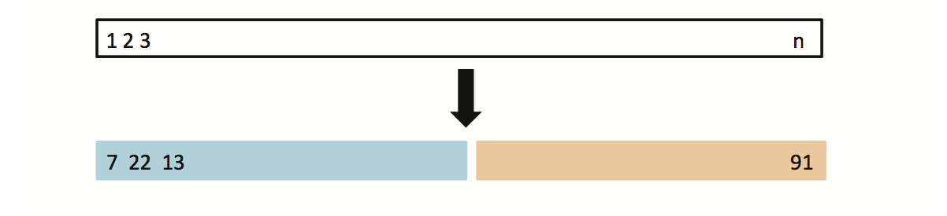
5.1.1 Typical Approach: The Validation Set Approach
Suppose that we would like to find a set of variables that give the lowest test (not training) error rate
If we have a large data set, we can achieve this goal by randomly splitting the data into training and validation(testing) parts
We would then use the training part to build each possible model (i.e. the different combinations of variables) and choose the model that gave the lowest error rate when applied to the validation data
Training Data
Testing Data

Slide 5
Example: Auto Data
Suppose that we want to predict mpg from horsepower
Two models:
  mpg ~ horsepower
  mpg ~ horsepower + horspower²
Which model gives a better fit?
  Randomly split Auto data set into training (196 obs.) and validation data (196 obs.)
  Fit both models using the training data set
  Then, evaluate both models using the validation data set
  The model with the lowest validation (testing) MSE is the winner!

Slide 6
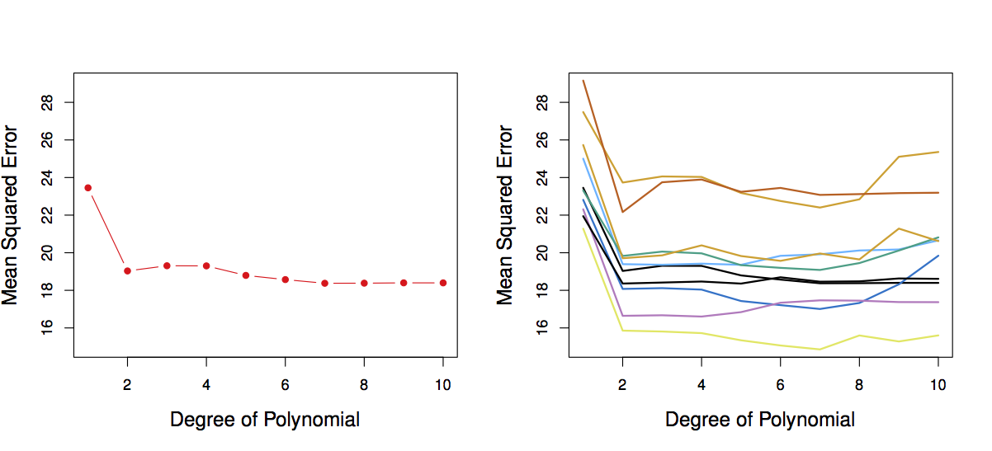
Results: Auto Data
Left: Validation error rate for a single split
Right: Validation method repeated 10 times, each time the split is done randomly!
There is a lot of variability among the MSE’s… Not good! We need more stable methods!

Slide 7
The Validation Set Approach
Advantages:
  Simple
  Easy to implement
Disadvantages:
  The validation MSE can be highly variable
  Only a subset of observations are used to fit the model (training data). Statistical methods tend to perform worse when trained on fewer observations

Slide 8
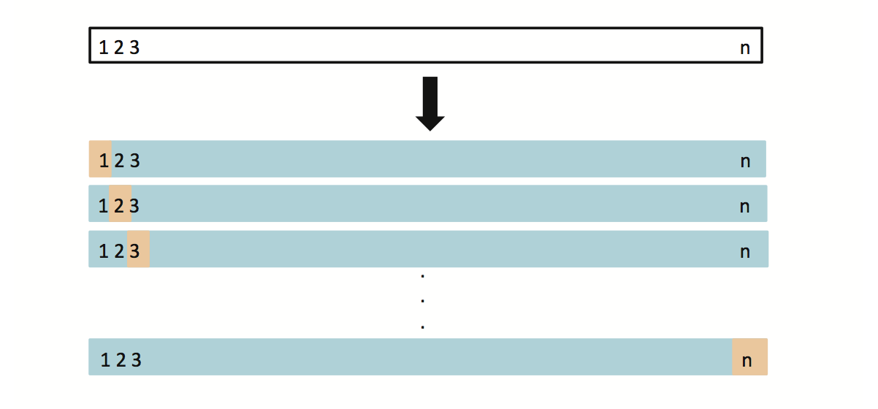
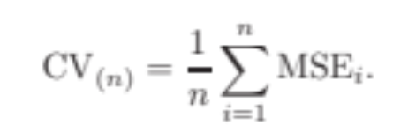
5.1.2 Leave-One-Out Cross Validation (LOOCV)
This method is similar to the Validation Set Approach, but it tries to address the latter’s disadvantages
For each suggested model, do:
  Split the data set of size n into
    Training data set (blue) size: n -1
    Validation data set (beige) size: 1
  Fit the model using the training data
  Validate model using the validation data, and compute the corresponding MSE
  Repeat this process n times
  The MSE for the model is computed as follows:

Slide 9
LOOCV vs. the Validation Set Approach
LOOCV has less bias
  We repeatedly fit the statistical learning method using training data that contains n-1 obs., i.e. almost all the data set is used
LOOCV produces a less variable MSE
  The validation approach produces different MSE when applied repeatedly due to randomness in the splitting process, while performing LOOCV multiple times will always yield the same results, because we split based on 1 obs. each time
LOOCV is computationally intensive (disadvantage)
  We fit the each model n times!

Slide 10
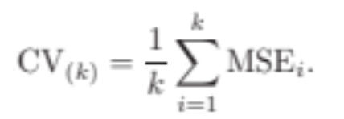
5.1.3 k-fold Cross Validation
LOOCV is computationally intensive, so we can run k-fold Cross Validation instead
With k-fold Cross Validation, we divide the data set into K different parts (e.g. K = 5, or K = 10, etc.)
We then remove the first part, fit the model on the remaining K-1 parts, and see how good the predictions are on the left out part (i.e. compute the MSE on the first part)
We then repeat this K different times taking out a different part each time
By averaging the K different MSE’s we get an estimated validation (test) error rate for new observations

Slide 11
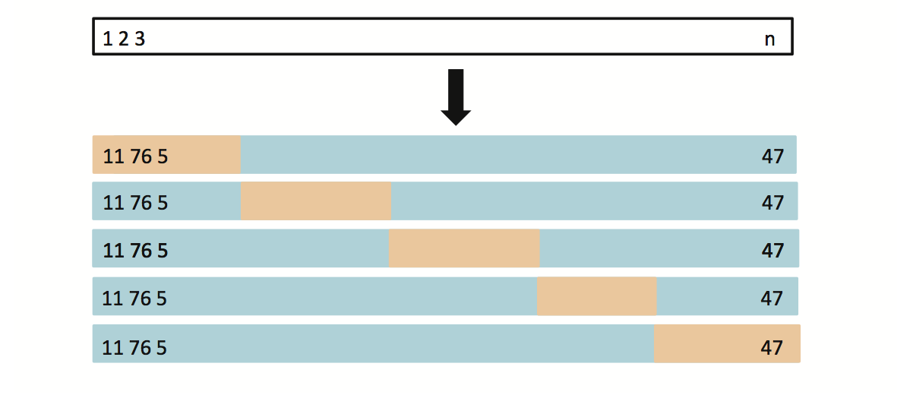
K-fold Cross Validation

Slide 12
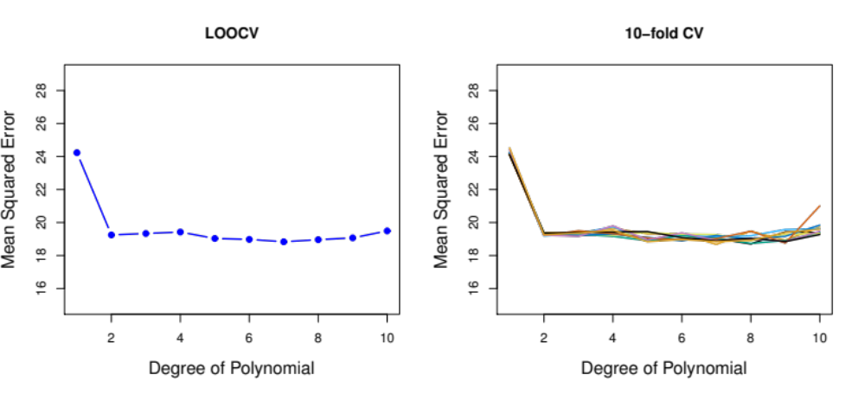
Auto Data: LOOCV vs. K-fold CV
Left: LOOCV error curve
Right: 10-fold CV was run many times, and the figure shows the slightly different CV error rates
LOOCV is a special case of k-fold, where k = n
They are both stable, but LOOCV is more computationally intensive!

Slide 13
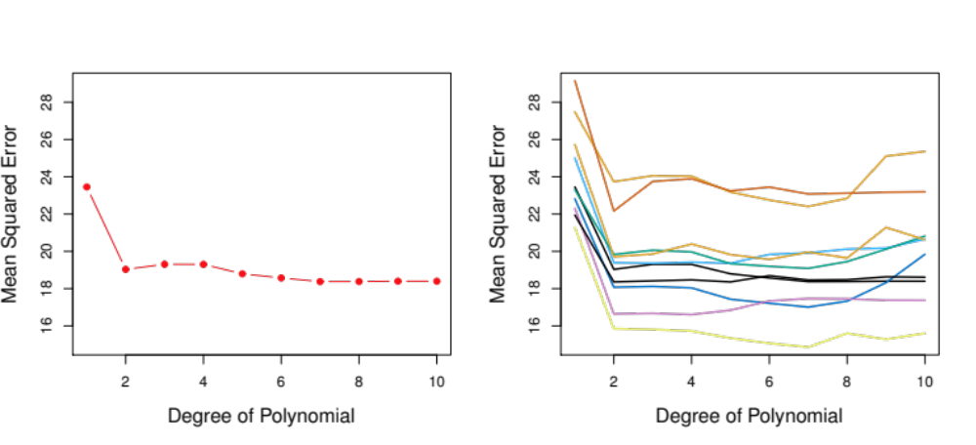
Auto Data: Validation Set Approach vs. K-fold CV Approach
Left: Validation Set Approach
Right: 10-fold Cross Validation Approach
Indeed, 10-fold CV is more stable!

Slide 14
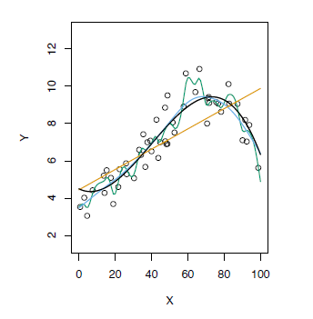
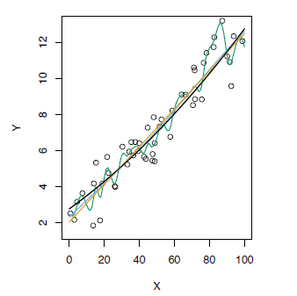
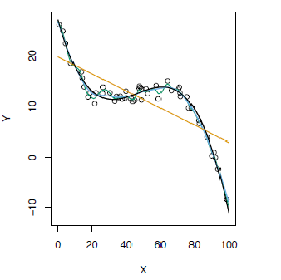
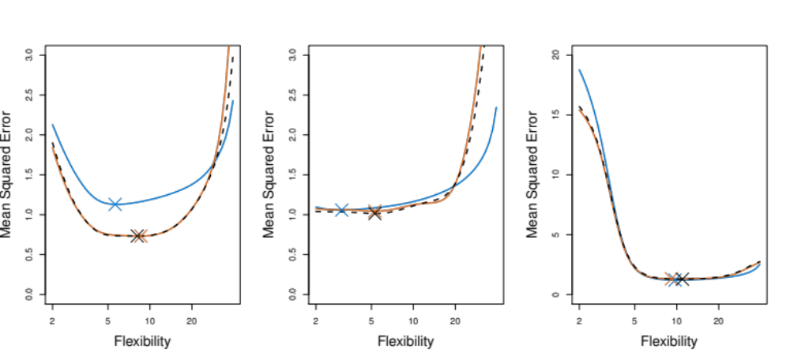
K-fold Cross Validation on Three Simulated Date
Blue: True Test MSE
Black: LOOCV MSE
Orange: 10-fold MSE
Refer to chapter 2 for the top graphs, Fig 2.9, 2.10, and 2.11

Slide 15
5.1.4 Bias- Variance Trade-off for k-fold CV
Putting aside that LOOCV is more computationally intensive than k-fold CV… Which is better LOOCV or K-fold CV?
  LOOCV is less bias than k-fold CV (when k < n)
  But, LOOCV has higher variance than k-fold CV (when k < n)
  Thus, there is a trade-off between what to use
Conclusion:
  We tend to use k-fold CV with (K = 5 and K = 10)
  These are the magical K’s ☺
  It has been empirically shown that they yield test error rate estimates that suffer neither from excessively high bias, nor from very high variance

Slide 16
5.1.5 Cross Validation on Classification Problems
So far, we have been dealing with CV on regression problems
We can use cross validation in a classification situation in a similar manner
  Divide data into K parts
  Hold out one part, fit using the remaining data and compute the error rate on the hold out data
  Repeat K times
  CV error rate is the average over the K errors we have computed

Slide 17
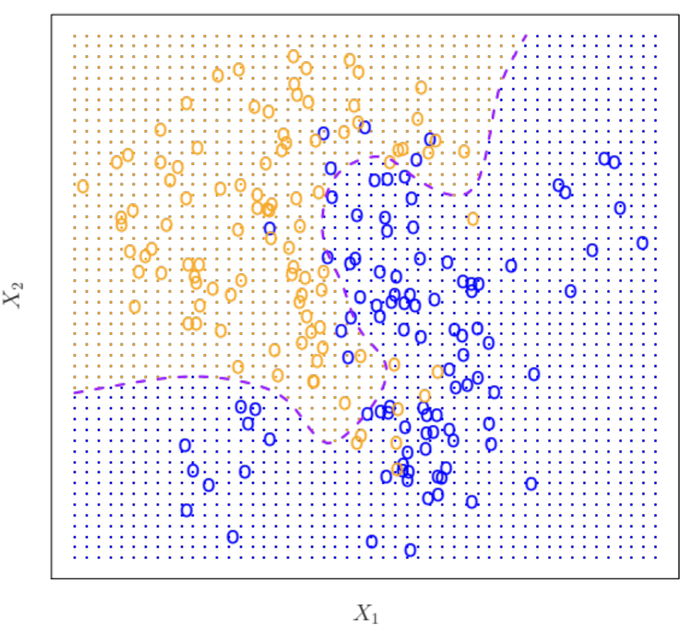
CV to Choose Order of Polynomial
The data set used is simulated (refer to Fig 2.13)
The purple dashed line is the Bayes’ boundary
Bayes’ Error Rate: 0.133

Slide 18
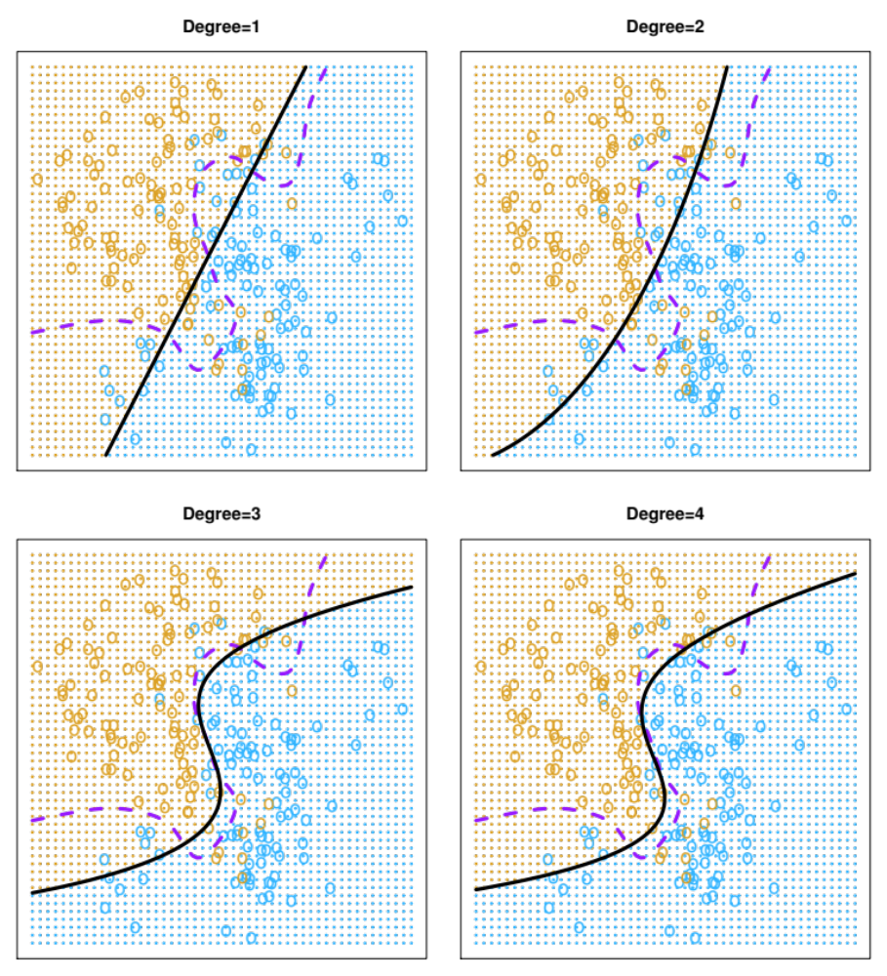
Linear Logistic regression (Degree 1) is not able to fit the Bayes’ decision boundary
Quadratic Logistic regression does better than linear
Error Rate: 0.201
Error Rate: 0.197

Slide 19
Using cubic and quartic predictors, the accuracy of the model improves
Error Rate: 0.160
Error Rate: 0.162

Slide 20
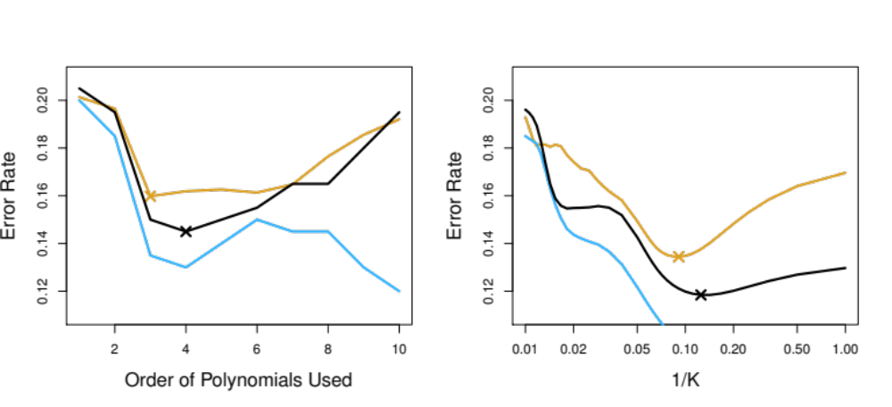
CV to Choose the Order
Logistic Regression
KNN
Brown: Test Error
Blue: Training Error
Black: 10-fold CV Error

