Slide 1
Classification MEthods
Chapter 04 (part 01)

Slide 2
Logistic Regression

Slide 3
Outline
Cases:
  Orange Juice Brand Preference
  Credit Card Default Data
Why Not Linear Regression?
Simple Logistic Regression
  Logistic Function
  Interpreting the coefficients
  Making Predictions
  Adding Qualitative Predictors
Multiple Logistic Regression

Slide 4
Case 1: Brand Preference for Orange Juice
We would like to predict what customers prefer to buy: Citrus Hill or Minute Maid orange juice?
The Y (Purchase) variable is categorical: 0 or 1
The X (LoyalCH) variable is a numerical value (between 0 and 1) which specifies the how much the customers are loyal to the Citrus Hill (CH) orange juice
Can we use Linear Regression when Y is categorical?

Slide 5
Why not Linear Regression?
When Y only takes on values of 0 and 1, why standard linear regression in inappropriate?
0.9
How do we interpret values greater than 1?
0.7
Purchase
0.5
0.4
0.2
How do we interpret values of Y between 0 and 1?
0.0
.0
.1
.2
.3
.4
.5
.6
.7
.8
.9
1.0
LoyalCH

Slide 6
Problems
The regression line β₀+β₁X can take on any value between negative and positive infinity
In the orange juice classification problem, Y can only take on two possible values: 0 or 1.
Therefore the regression line almost always predicts the wrong value for Y in classification problems

Slide 7
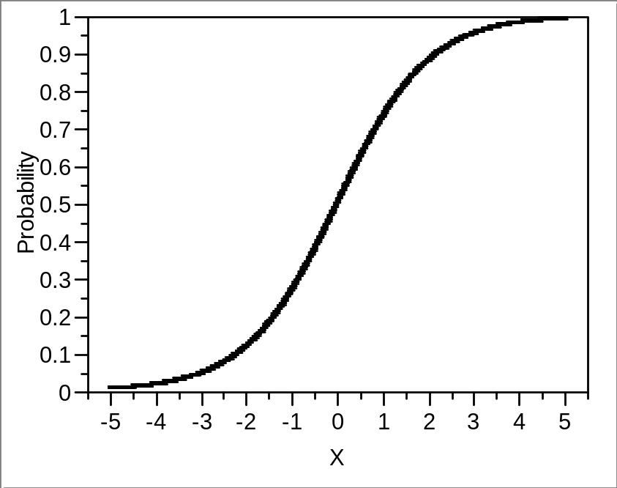
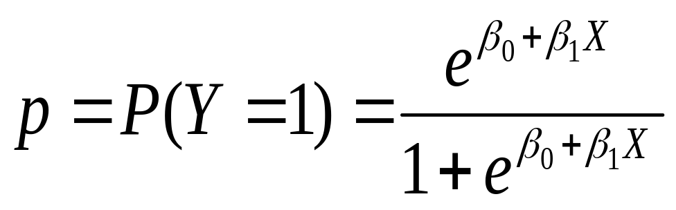
Solution: Use Logistic Function
Instead of trying to predict Y, let’s try to predict P(Y = 1), i.e., the probability a customer buys Citrus Hill (CH) juice.
Thus, we can model P(Y = 1) using a function that gives outputs between 0 and 1.
We can use the logistic function
Logistic Regression!

Slide 8
Logistic Regression
Logistic regression is very similar to linear regression
We come up with b₀ and b₁ to estimate β₀ and β₁.
We have similar problems and questions as in linear regression
  e.g. Is β₁ equal to 0? How sure are we about our guesses for β₀ and β₁?
1
MM
0.75
0.5
P(Purchase)
CH
0.25
0
.0
.2
.4
.6
.7
.9
LoyalCH
If LoyalCH is about .6 then Pr(CH) ≈ .7.

Slide 9
Case 2: Credit Card Default Data
We would like to be able to predict customers that are likely to default
Possible X variables are:
  Annual Income
  Monthly credit card balance
The Y variable (Default) is categorical: Yes or No
How do we check the relationship between Y and X?

Slide 10
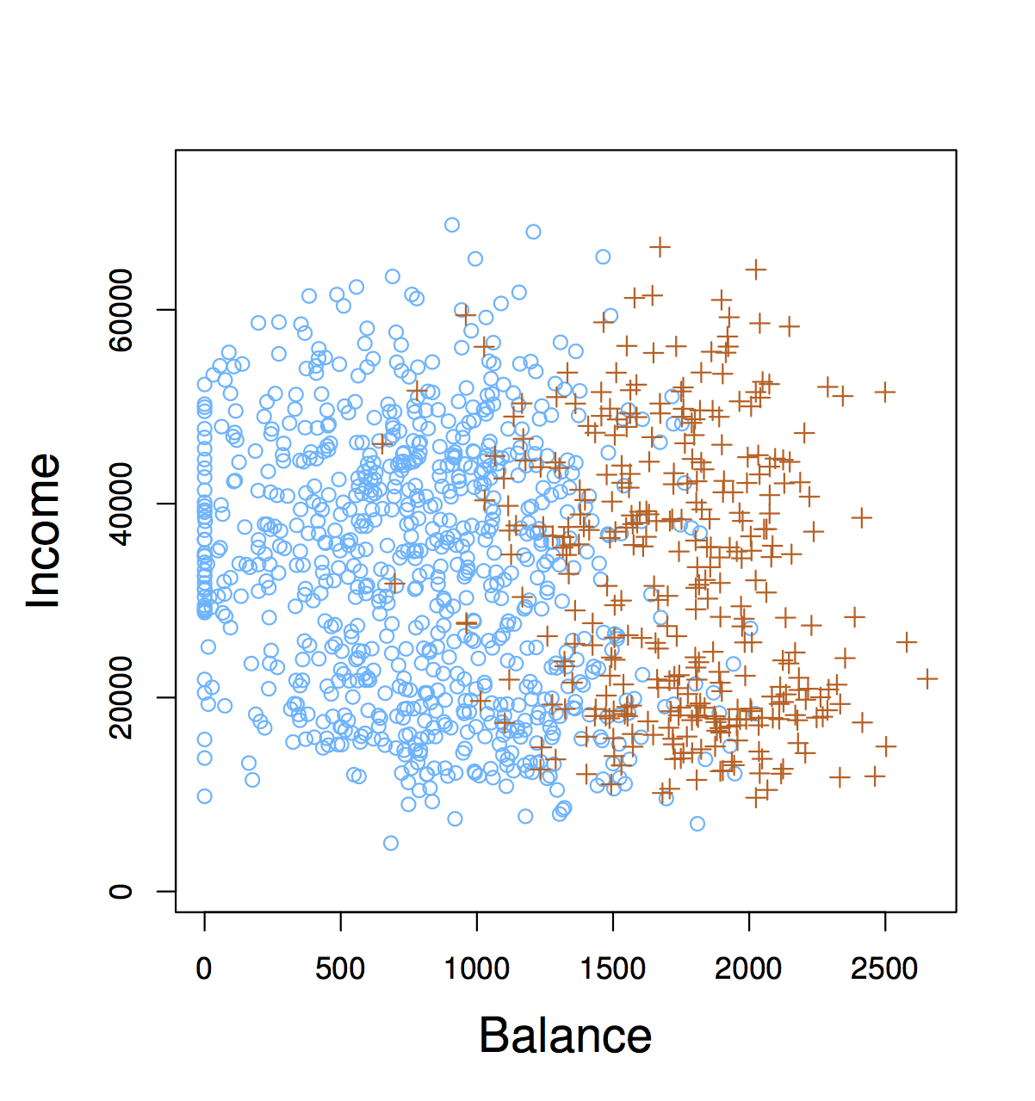
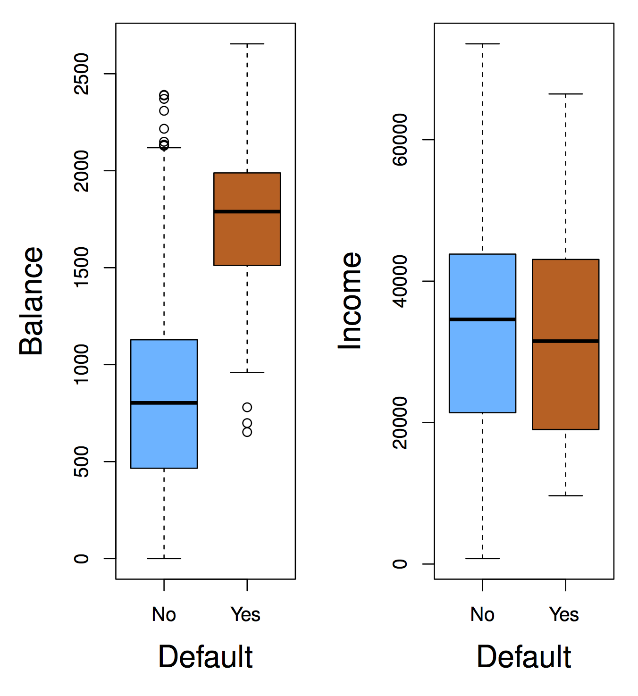
The Default Dataset

Slide 11
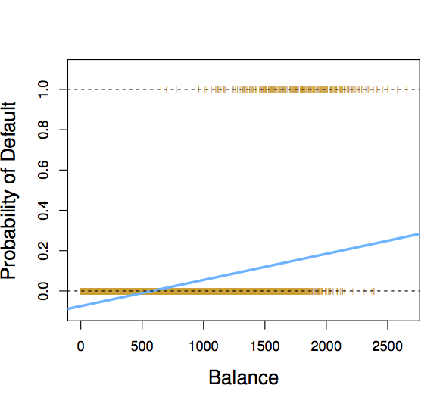
Why not Linear Regression?
If we fit a linear regression to the Default data, then for very low balances we predict a negative probability, and for high balances we predict a probability above 1!
When Balance < 500,
Pr(default) is negative!

Slide 12
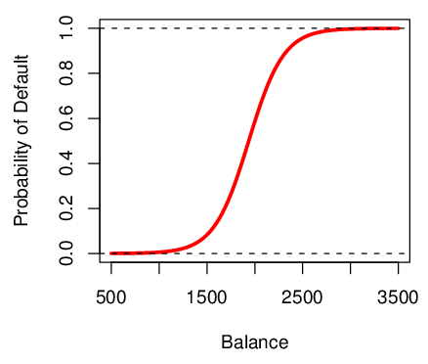
Logistic Function on Default Data
Now the probability of default is close to, but not less than zero for low balances. And close to but not above 1 for high balances

Slide 13
Interpreting β₁
Interpreting what β₁ means is not very easy with logistic regression, simply because we are predicting P(Y) and not Y.
If β₁ =0, this means that there is no relationship between Y and X.
If β₁ >0, this means that when X gets larger so does the probability that Y = 1.
If β₁ <0, this means that when X gets larger, the probability that Y = 1 gets smaller.
But how much bigger or smaller depends on where we are on the slope

Slide 14

Are the coefficients significant?
We still want to perform a hypothesis test to see whether we can be sure that are β₀ and β₁ significantly different from zero.
We use a Z test instead of a T test, but of course that doesn’t change the way we interpret the p-value
Here the p-value for balance is very small, and b₁ is positive, so we are sure that if the balance increase, then the probability of default will increase as well.

Slide 15

Making Prediction
Suppose an individual has an average balance of $1000. What is their probability of default?
The predicted probability of default for an individual with a balance of $1000 is less than 1%.
For a balance of $2000, the probability is much higher, and equals to 0.586 (58.6%).

Slide 16
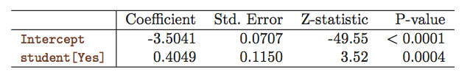
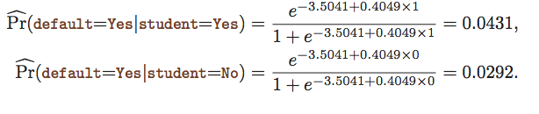
Qualitative Predictors in Logistic Regression
We can predict if an individual default by checking if she is a student or not. Thus we can use a qualitative variable “Student” coded as (Student = 1, Non-student =0).
b₁ is positive: This indicates students tend to have higher default probabilities than non-students

Slide 17

Multiple Logistic Regression
We can fit multiple logistic just like regular regression

Slide 18
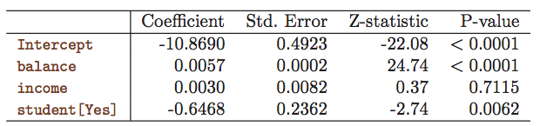
Multiple Logistic Regression- Default Data
Predict Default using:
  Balance (quantitative)
  Income (quantitative)
  Student (qualitative)

Slide 19

Predictions
A student with a credit card balance of $1,500 and an income of $40,000 has an estimated probability of default

Slide 20
An Apparent Contradiction!
Positive
Negative

Slide 21
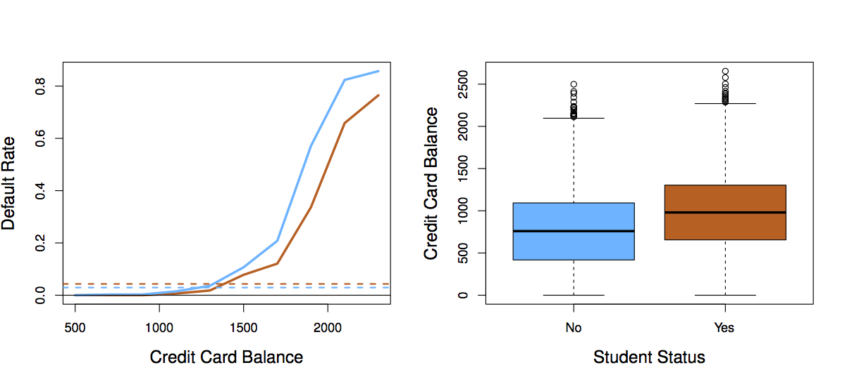
Students (Orange) vs. Non-students (Blue)

Slide 22
To whom should credit be offered?
A student is risker than non students if no information about the credit card balance is available
However, that student is less risky than a non student with the same credit card balance!

