Slide 1
Classification MEthods
Chapter 04 (part 02)

Slide 2
Linear Discriminant Analysis (LDA) &
Quadratic Discriminant Analysis (QDA)

Slide 3
Outline
Overview of LDA
Why not Logistic Regression?
Estimating Bayes’ Classifier
LDA Example with One Predictor (p=1)
LDA Example with more than One Predictor (P>1)
LDA on Default Data
Overview of QDA
Comparison between LDA and QDA

Slide 4
Linear Discriminant Analysis
LDA undertakes the same task as Logistic Regression. It classifies data based on categorical variables
  Making profit or not
  Buy a product or not
  Satisfied customer or not
  Political party voting intention

Slide 5
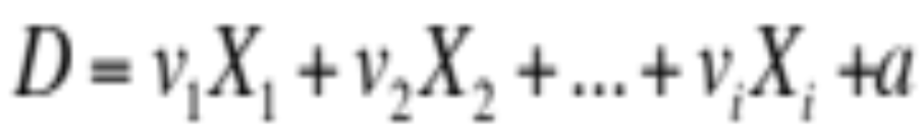
Why Linear? Why Discriminant?
LDA involves the determination of linear equation (just like linear regression) that will predict which group the case belongs to.
  D: discriminant function
  v: discriminant coefficient or weight for the variable
  X: variable
  a: constant

Slide 6
Purpose of LDA
Choose the v’s in a way to maximize the distance between the means of different categories
Good predictors tend to have large v’s (weight)
We want to discriminate between the different categories
Think of food recipe. Changing the proportions (weights) of the ingredients will change the characteristics of the finished cakes. Hopefully that will produce different types of cake!

Slide 7
Assumptions of LDA
The observations are a random sample
Each predictor variable is normally distributed

Slide 8
Why not Logistic Regression?
Logistic regression is unstable when the classes are well separated
In the case where n is small, and the distribution of predictors X is approximately normal, then LDA is more stable than Logistic Regression
LDA is more popular when we have more than two response classes

Slide 9
Bayes’ Classifier
Bayes’ classifier is the golden standard. Unfortunately, it is unattainable.
So far, we have estimated it with two methods:
  KNN classifier
  Logistic Regression

Slide 10
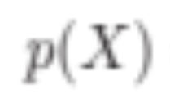

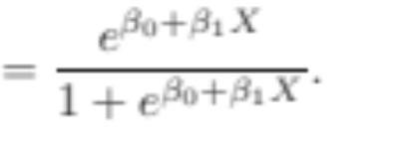
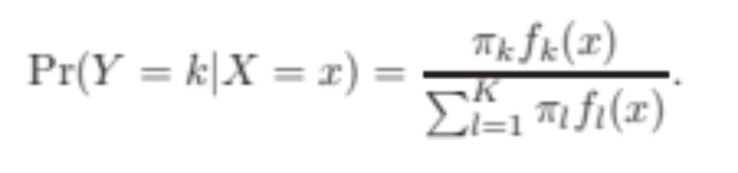

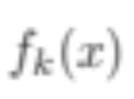
Estimating Bayes’ Classifier
With Logistic Regression we modeled the probability of Y being from the k^{th} class as
=
However, Bayes’ Theorem states
  =
  : Probability of coming from class k (prior probability)
  : Density function for X given that X is an observation from class k

Slide 11
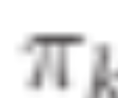
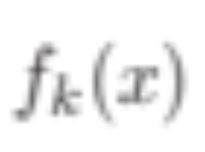
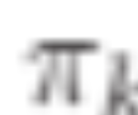
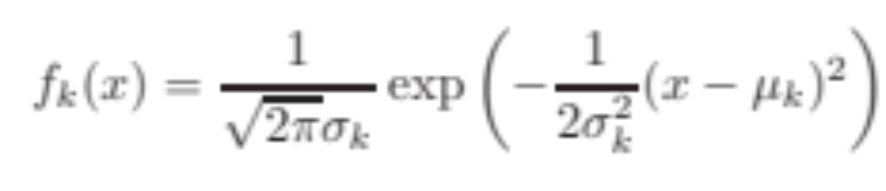
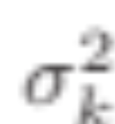

Estimate and
We can estimate and to compute
The most common model for is the Normal Density
Using the density, we only need to estimate three quantities to compute

Slide 12
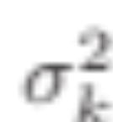
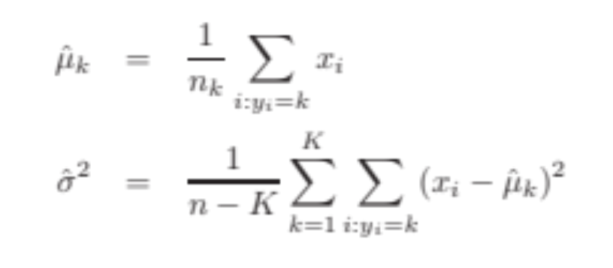
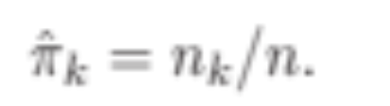
Use Training Data set for Estimation
The mean could be estimated by the average of all training observations from the k^{th} class.
The variance could be estimated as the weighted average of variances of all k classes.
And, is estimated as the proportion of the training observations that belong to the k^{th} class.

Slide 13
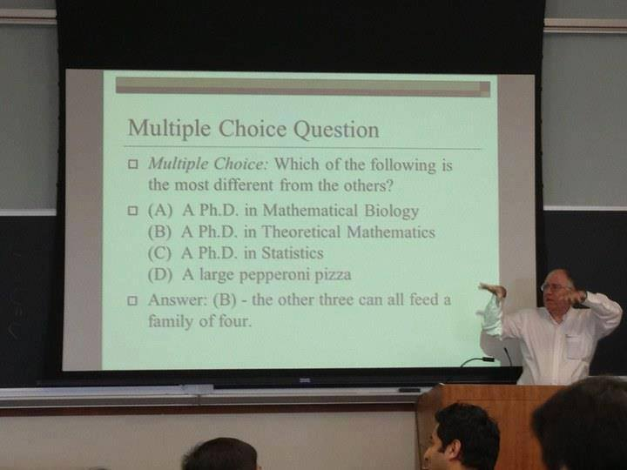

Slide 14
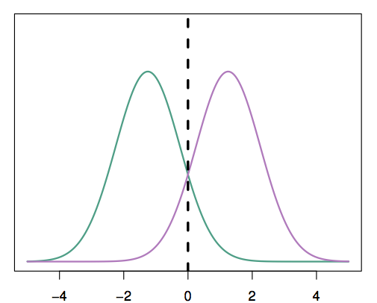
A Simple Example with One Predictor (p =1)
Suppose we have only one predictor (p = 1)
Two normal density function f₁(x) and f₂(x), represent two distinct classes
The two density functions overlap, so there is some uncertainty about the class to which an observation with an unknown class belongs
The dashed vertical line represents Bayes’ decision boundary

Slide 15
Apply LDA
LDA starts by assuming that each class has a normal distribution with a common variance
The mean and the variance are estimated
Finally, Bayes’ theorem is used to compute p_{k} and the observation is assigned to the class with the maximum probability among all k probabilities

Slide 16
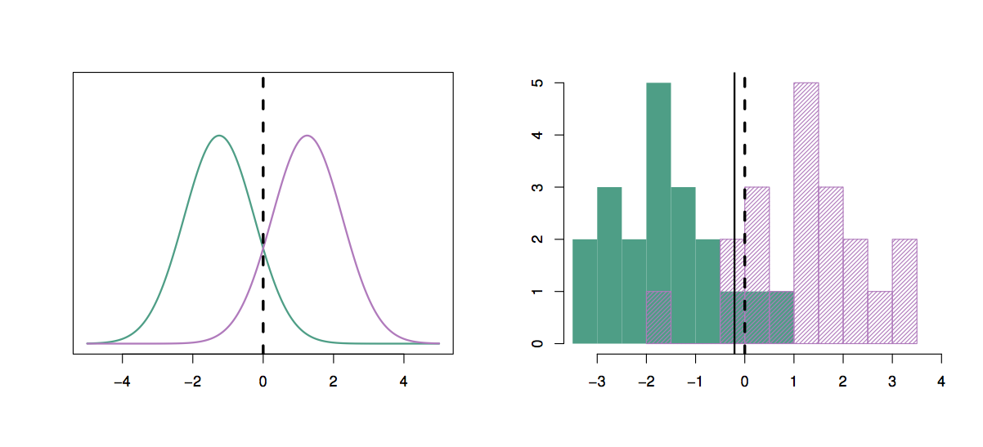
20 observations were drawn from each of the two classes
The dashed vertical line is the Bayes’ decision boundary
The solid vertical line is the LDA decision boundary
  Bayes’ error rate: 10.6%
  LDA error rate: 11.1%
Thus, LDA is performing pretty well!

Slide 17
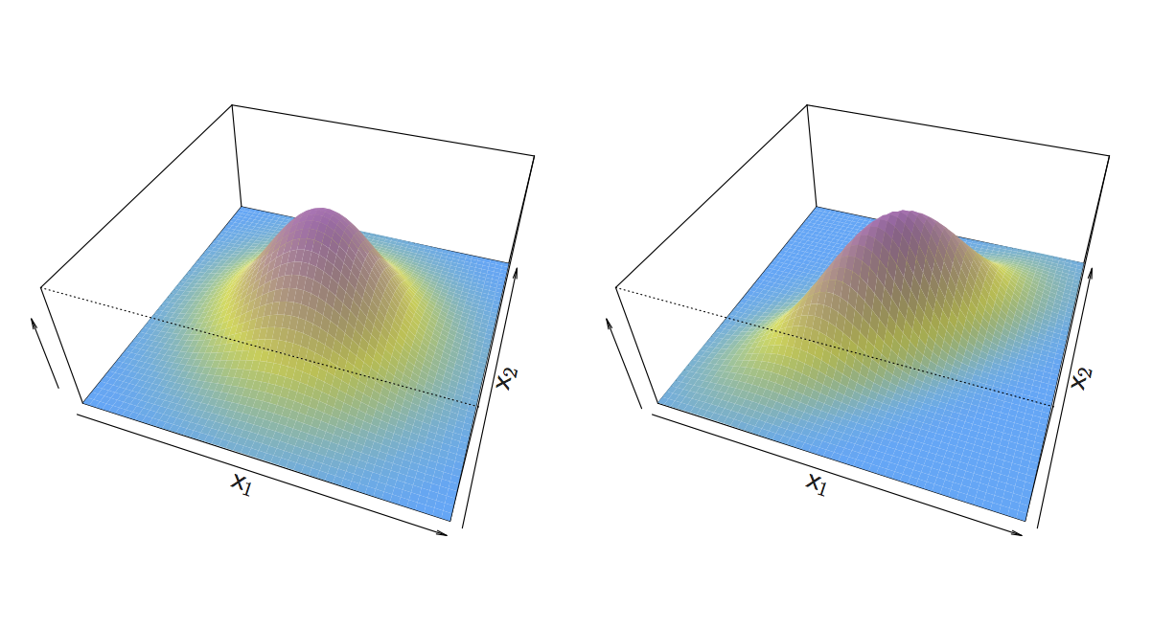
An Example When p > 1
If X is multidimensional (p > 1), we use exactly the same approach except the density function f(x) is modeled using the multivariate normal density

Slide 18
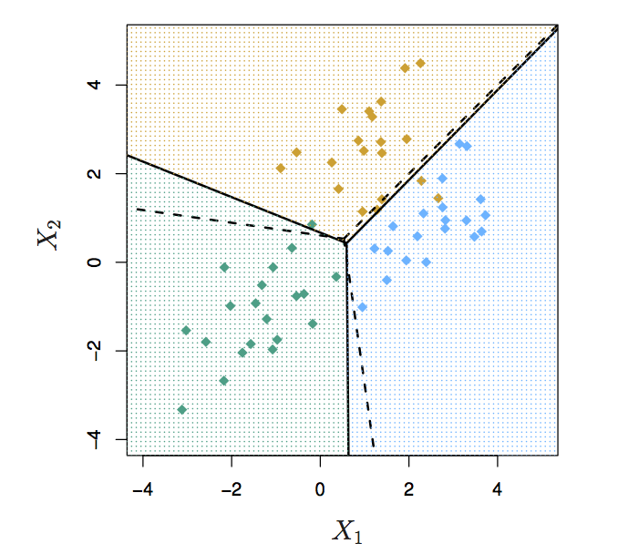
We have two predictors (p =2)
Three classes
20 observations were generated from each class
The solid lines are Bayes’ boundaries
The dashed lines are LDA boundaries

Slide 19
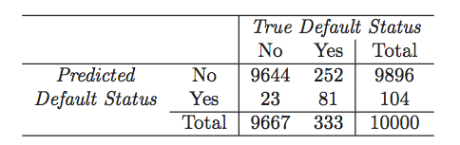
Running LDA on Default Data
LDA makes 252+ 23 mistakes on 10000 predictions (2.75% misclassification error rate)
But LDA miss-predicts 252/333 = 75.5% of defaulters!
Perhaps, we shouldn’t use 0.5 as threshold for predicting default?

Slide 20
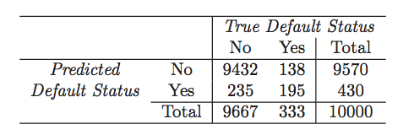
Use 0.2 as Threshold for Default
Now the total number of mistakes is 235+138 = 373 (3.73% misclassification error rate)
But we only miss-predicted 138/333 = 41.4% of defaulters
We can examine the error rate with other thresholds

Slide 21
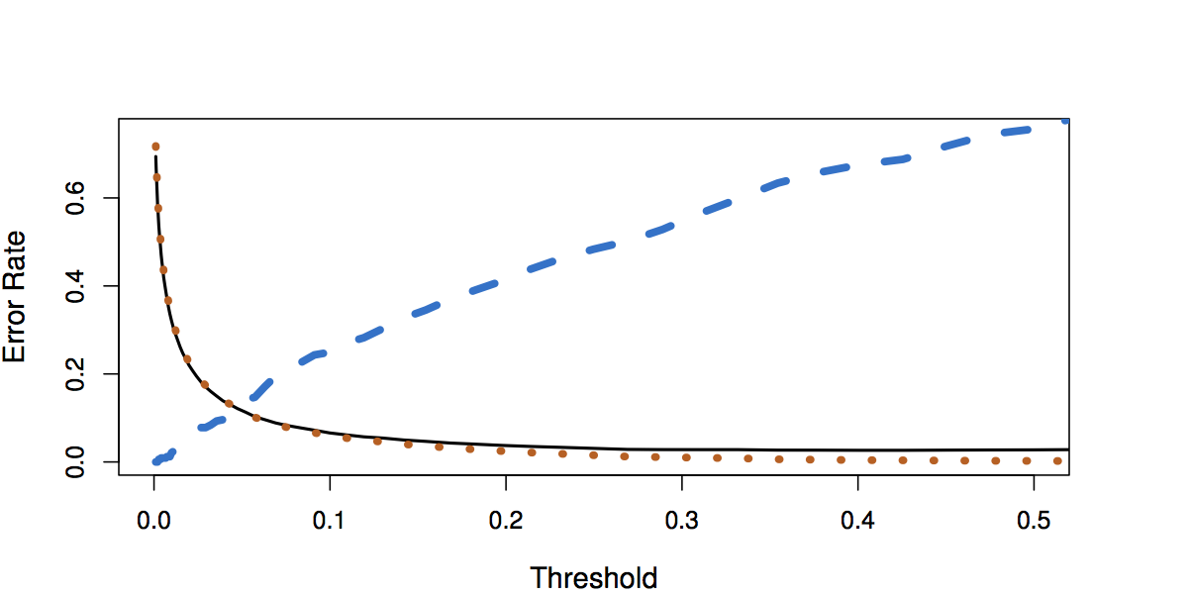
Default Threshold Values vs. Error Rates
Black solid: overall error rate
Blue dashed: Fraction of defaulters missed
Orange dotted: non defaulters incorrectly classified

Slide 22
Quadratic Discriminant Analysis (QDA)
LDA assumed that every class has the same variance/ covariance
However, LDA may perform poorly if this assumption is far from true
QDA works identically as LDA except that it estimates separate variances/ covariance for each class

Slide 23
Which is better? LDA or QDA?
Since QDA allows for different variances among classes, the resulting boundaries become quadratic
Which approach is better: LDA or QDA?
  QDA will work best when the variances are very different between classes and we have enough observations to accurately estimate the variances
  LDA will work best when the variances are similar among classes or we don’t have enough data to accurately estimate the variances

Slide 24
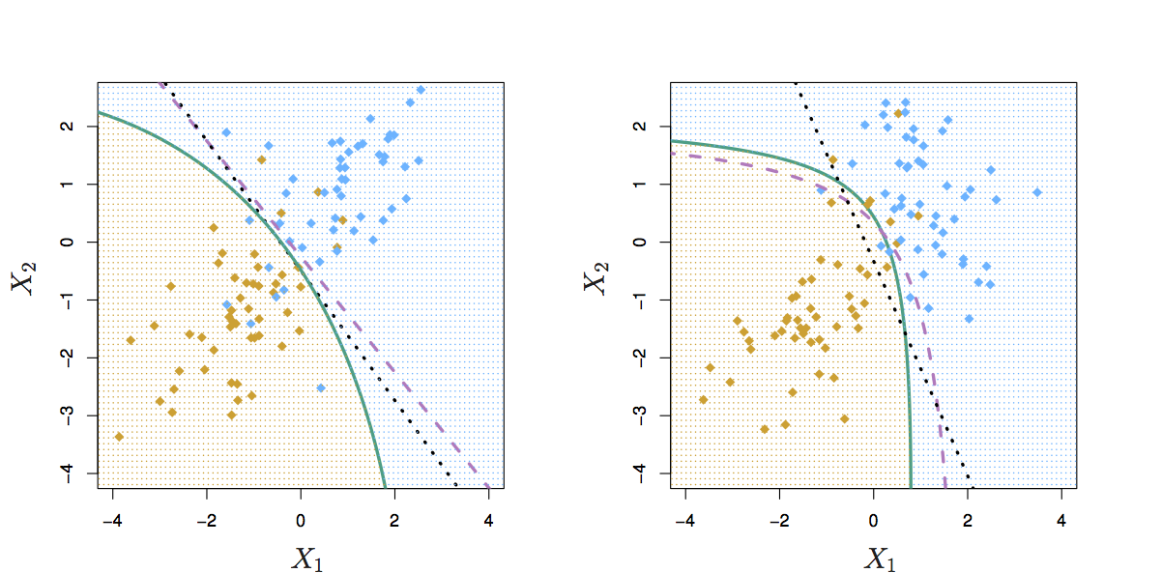
Comparing LDA to QDA
Black dotted: LDA boundary
Purple dashed: Bayes’ boundary
Green solid: QDA boundary
Left: variances of the classes are equal (LDA is better fit)
Right: variances of the classes are not equal (QDA is better fit)

Slide 25
Comparison of Classification Methods
KNN (Chapter 2)
Logistic Regression (Chapter 4)
LDA (Chapter 4)
QDA (Chapter 4)

Slide 26
Logistic Regression vs. LDA
Similarity: Both Logistic Regression and LDA produce linear boundaries
Difference: LDA assumes that the observations are drawn from the normal distribution with common variance in each class, while logistic regression does not have this assumption. LDA would do better than Logistic Regression if the assumption of normality hold, otherwise logistic regression can outperform LDA

Slide 27
KNN vs. (LDA and Logistic Regression)
KNN takes a completely different approach
KNN is completely non-parametric: No assumptions are made about the shape of the decision boundary!
Advantage of KNN: We can expect KNN to dominate both LDA and Logistic Regression when the decision boundary is highly non-linear
Disadvantage of KNN: KNN does not tell us which predictors are important (no table of coefficients)

Slide 28
QDA vs. (LDA, Logistic Regression, and KNN)
QDA is a compromise between non-parametric KNN method and the linear LDA and logistic regression
If the true decision boundary is:
  Linear: LDA and Logistic outperforms
  Moderately Non-linear: QDA outperforms
  More complicated: KNN is superior

