Slide 1
Linear Regression
Chapter 03

Slide 2
Outline
The Linear Regression Model
  Least Squares Fit
  Measures of Fit
  Inference in Regression
Other Considerations in Regression Model
  Qualitative Predictors
  Interaction Terms
Potential Fit Problems
Linear vs. KNN Regression

Slide 3
Outline
The Linear Regression Model
  Least Squares Fit
  Measures of Fit
  Inference in Regression
Other Considerations in Regression Model
  Qualitative Predictors
  Interaction Terms
Potential Fit Problems
Linear vs. KNN Regression

Slide 4
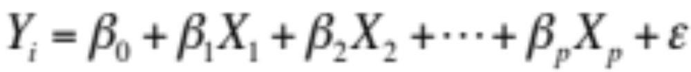
The Linear Regression Model
The parameters in the linear regression model are very easy to interpret.
β₀ is the intercept (i.e. the average value for Y if all the X’s are zero), β_{j} is the slope for the jth variable X_{j}
β_{j} is the average increase in Y when X_{j} is increased by one and all other X’s are held constant.

Slide 5
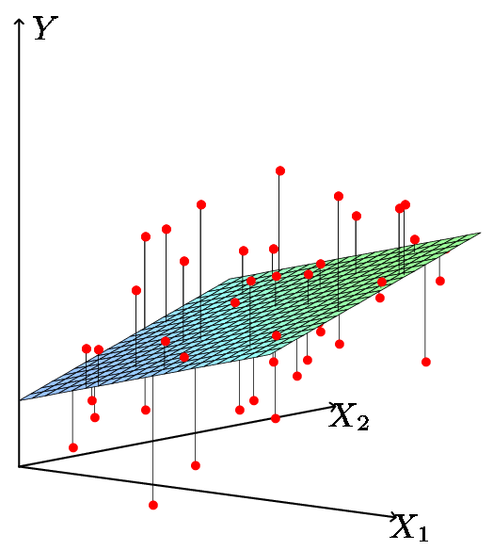
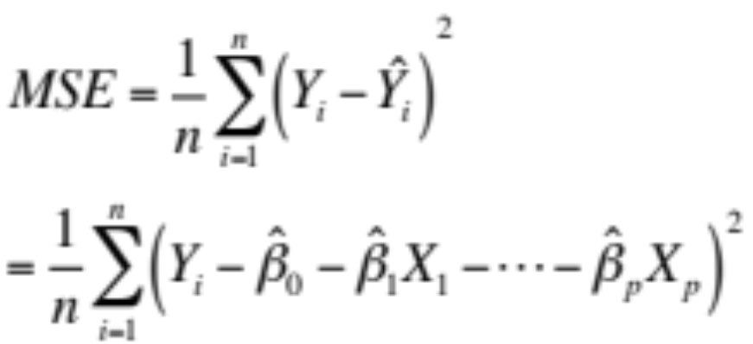
Least Squares Fit
We estimate the parameters using least squares i.e. minimize

Slide 6
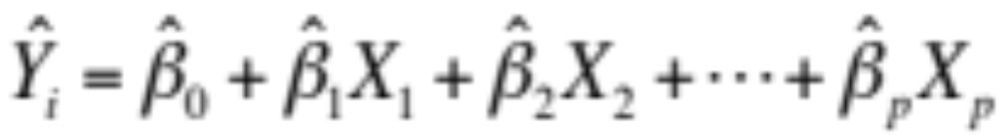




Relationship between population and least squares lines
Population line
Least Squares line
We would like to know β₀ through β_{p} i.e. the population line. Instead we know through i.e. the least squares line.
Hence we use through as guesses for β₀ through β_{p} and as a guess for Y_{i}. The guesses will not be perfect just as is not a perfect guess for μ.

Slide 7
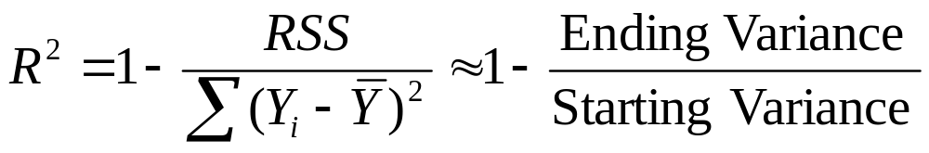
Measures of Fit: R²
Some of the variation in Y can be explained by variation in the X’s and some cannot.
R² tells you the fraction of variance that can be explained by X.
R² is always between 0 and 1. Zero means no variance has been explained. One means it has all been explained (perfect fit to the data).

Slide 8

Inference in Regression
Estimated (least squares) line.
The regression line from the sample is not the regression line from the population.
What we want to do:
  Assess how well the line describes the plot.
  Guess the slope of the population line.
  Guess what value Y would take for a given X value
14
12
10
8
6
4
2
0
-10
-5
0
5
10
X
True (population) line. Unobserved

Slide 9
Some Relevant Questions
Is β_{j}=0 or not? We can use a hypothesis test to answer this question. If we can’t be sure that β_{j}≠0 then there is no point in using X_{j} as one of our predictors.
Can we be sure that at least one of our X variables is a useful predictor i.e. is it the case that β₁= β₂=⋅⋅⋅= β _{p}=0?

Slide 10
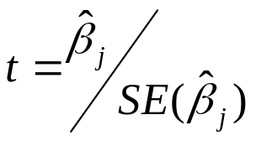
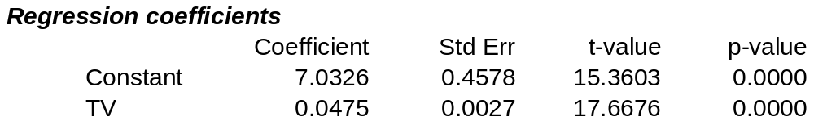

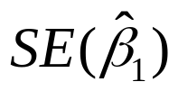
1. Is β_{j}=0 i.e. is X_{j} an important variable?
We use a hypothesis test to answer this question
H₀: β_{j}=0 vs H_{a}: β_{j}≠0
Calculate
If t is large (equivalently p-value is small) we can be sure that β_{j}≠0 and that there is a relationship
Number of standard deviations away from zero.
P-value
is 17.67 SE’s from 0

Slide 11
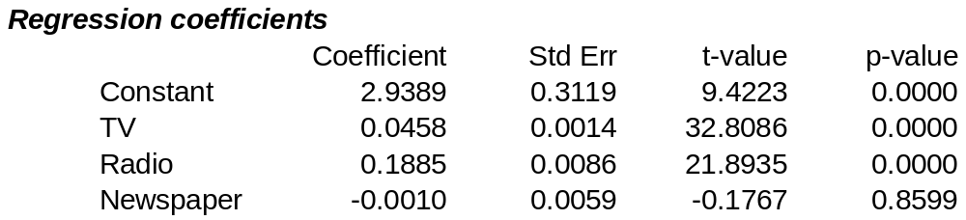
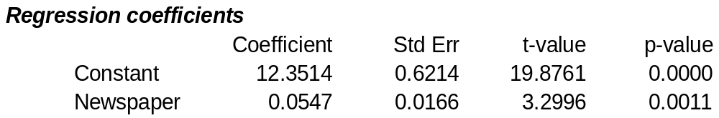
Testing Individual Variables
Is there a (statistically detectable) linear relationship between Newspapers and Sales after all the other variables have been accounted for?
No: big p-value
Small p-value in simple regression
Almost all the explaining that Newspapers could do in simple regression has already been done by TV and Radio in multiple regression!

Slide 12
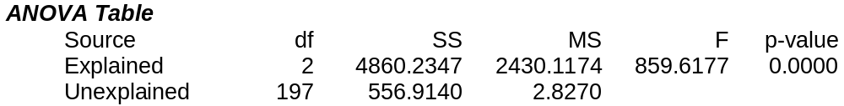
2. Is the whole regression explaining anything at all?
Test for:
H₀: all slopes = 0 (β₁=β₂=⋅⋅⋅=β_{p}=0),
H_{a}: at least one slope ≠ 0
Answer comes from the F test in the ANOVA (ANalysis Of VAriance) table.
The ANOVA table has many pieces of information. What we care about is the F Ratio and the corresponding p-value.

Slide 13
Outline
The Linear Regression Model
  Least Squares Fit
  Measures of Fit
  Inference in Regression
Other Considerations in Regression Model
  Qualitative Predictors
  Interaction Terms
Potential Fit Problems
Linear vs. KNN Regression

Slide 14
Qualitative Predictors
How do you stick “men” and “women” (category listings) into a regression equation?
Code them as indicator variables (dummy variables)
For example we can “code” Males=0 and Females= 1.

Slide 15
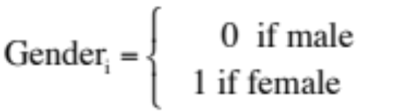
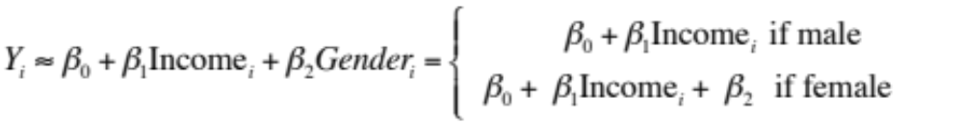
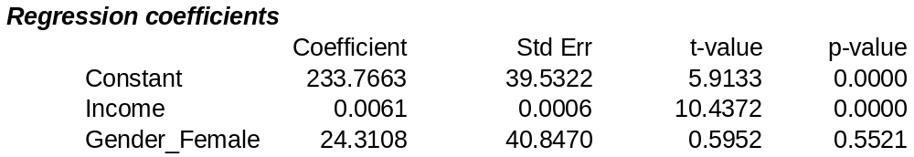
Interpretation
Suppose we want to include income and gender.
Two genders (male and female). Let
then the regression equation is
β₂ is the average extra balance each month that females have for given income level. Males are the “baseline”.

Slide 16
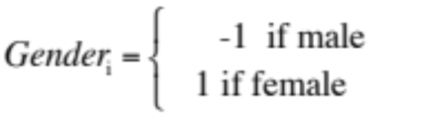
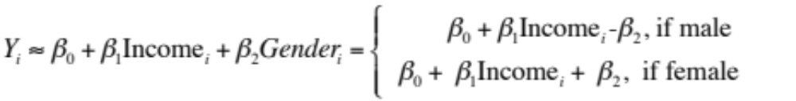
Other Coding Schemes
There are different ways to code categorical variables.
Two genders (male and female). Let
then the regression equation is
β₂ is the average amount that females are above the average, for any given income level. β₂ is also the average amount that males are below the average, for any given income level.

Slide 17
Other Issues Discussed
Interaction terms
Non-linear effects
Multicollinearity
Model Selection

Slide 18
Interaction
When the effect on Y of increasing X₁ depends on another X₂.
Example:
  Maybe the effect on Salary (Y) when increasing Position (X₁) depends on gender (X₂)?
  For example maybe Male salaries go up faster (or slower) than Females as they get promoted.
Advertising example:
  TV and radio advertising both increase sales.
  Perhaps spending money on both of them may increase sales more than spending the same amount on one alone?

Slide 19
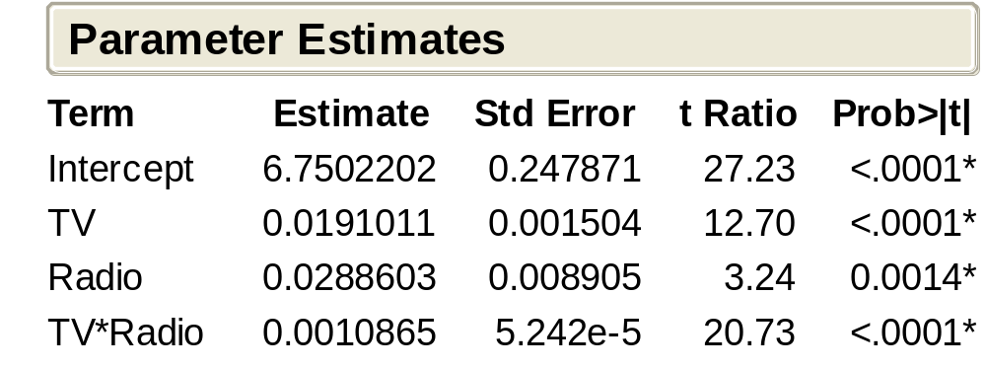
Interaction in advertising
Spending $1 extra on TV increases average sales by 0.0191 + 0.0011Radio
Spending $1 extra on Radio increases average sales by 0.0289 + 0.0011TV
Interaction Term

Slide 20
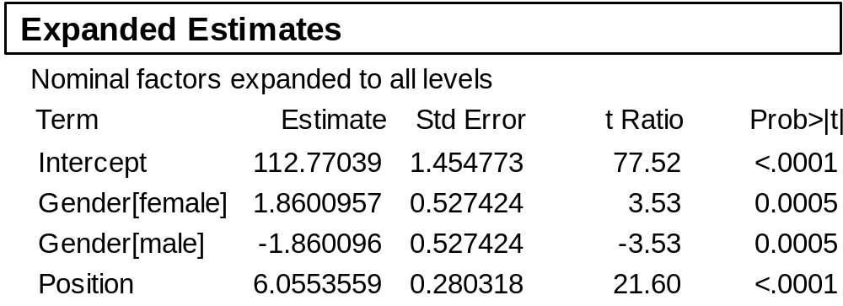
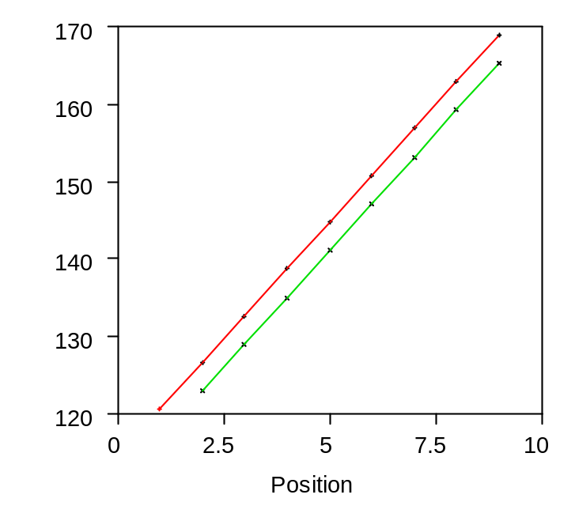
Parallel Regression Lines
Line for women
Regression equation
female: salary = 112.77+1.86 + 6.05× position
males: salary = 112.77-1.86 + 6.05 × position
Line for men
Parallel lines have the same slope. Dummy variables give lines different intercepts, but their slopes are still the same.
Different intercepts
Same slopes

Slide 21
Interaction Effects
Our model has forced the line for men and the line for women to be parallel.
Parallel lines say that promotions have the same salary benefit for men as for women.
If lines aren’t parallel then promotions affect men’s and women’s salaries differently.

Slide 22

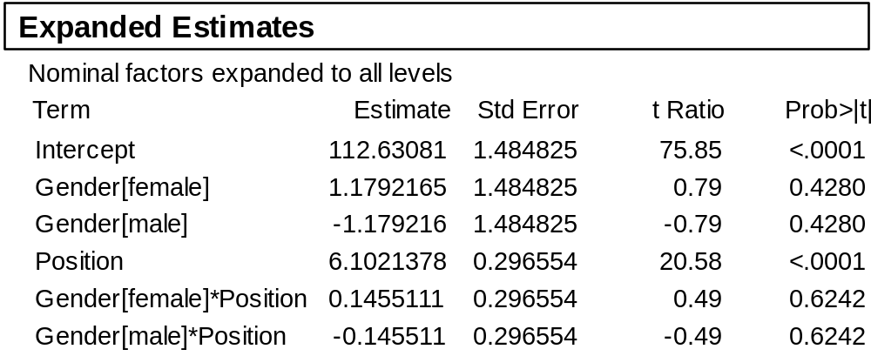
Should the Lines be Parallel?
170
160
150
140
130
120
110
0
1
2
3
4
5
6
7
8
9
10
Position
Interaction is not significant
Interaction between gender and position

Slide 23
Outline
The Linear Regression Model
  Least Squares Fit
  Measures of Fit
  Inference in Regression
Other Considerations in Regression Model
  Qualitative Predictors
  Interaction Terms
Potential Fit Problems
Linear vs. KNN Regression

Slide 24
Potential Fit Problems
There are a number of possible problems that one may encounter when fitting the linear regression model.
Non-linearity of the data
Dependence of the error terms
Non-constant variance of error terms
Outliers
High leverage points
Collinearity
See Section 3.3.3 for more details.

Slide 25
Outline
The Linear Regression Model
  Least Squares Fit
  Measures of Fit
  Inference in Regression
Other Considerations in Regression Model
  Qualitative Predictors
  Interaction Terms
Potential Fit Problems
Linear vs. KNN Regression

Slide 26
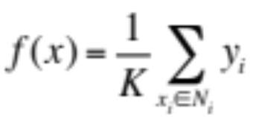
KNN Regression
kNN Regression is similar to the kNN classifier.
To predict Y for a given value of X, consider k closest points to X in training data and take the average of the responses. i.e.
If k is small kNN is much more flexible than linear regression.
Is that better?

Slide 27
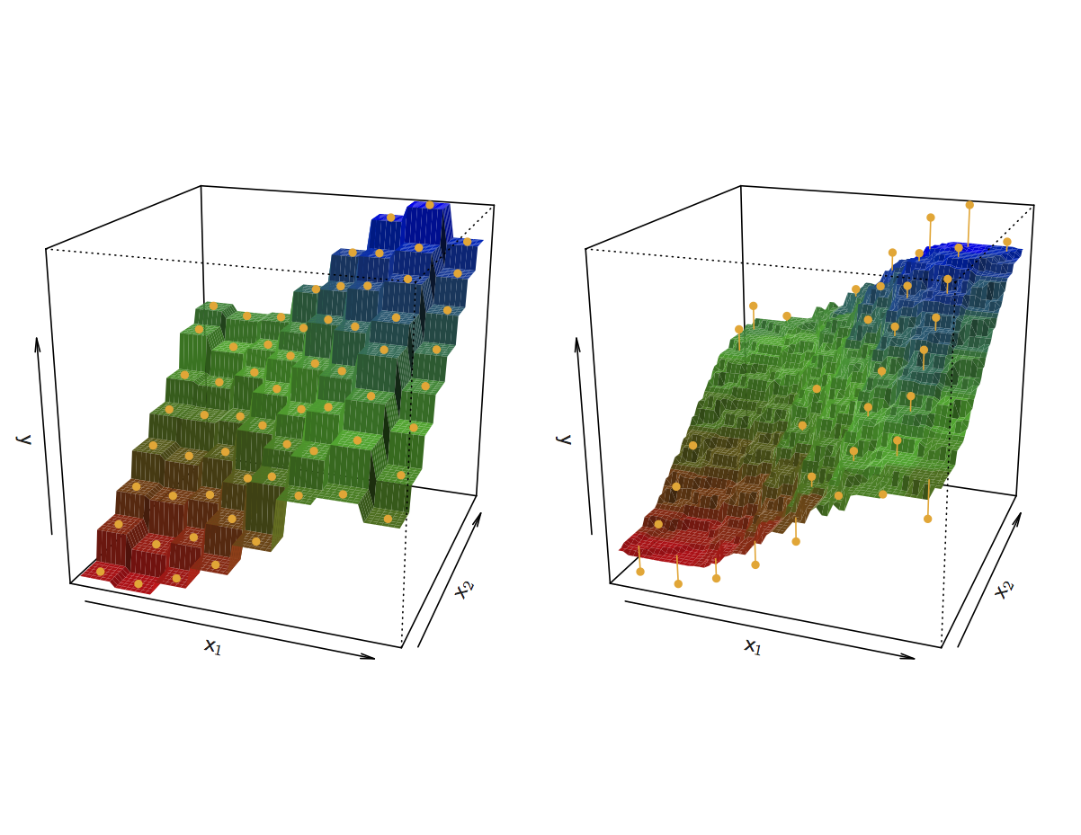
KNN Fits for k =1 and k = 9

Slide 28
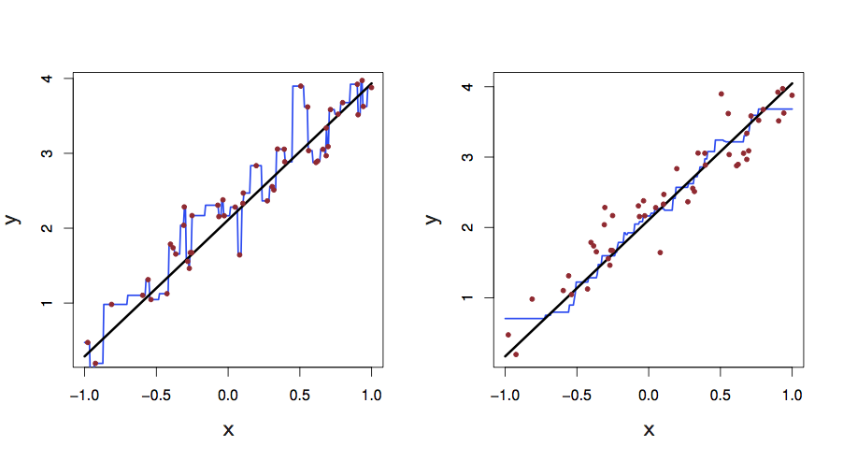
KNN Fits in One Dimension (k =1 and k = 9)

Slide 29
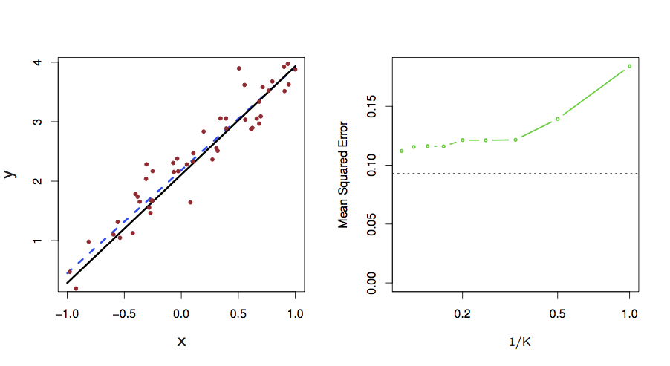
Linear Regression Fit

Slide 30
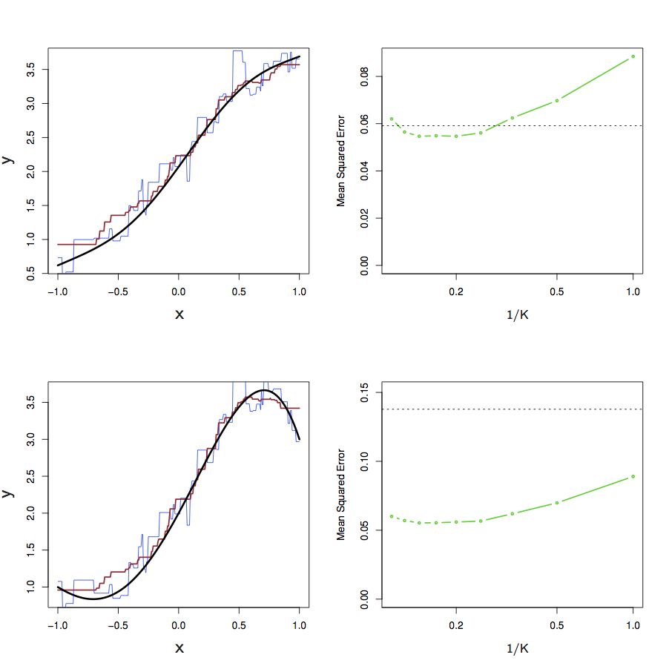
KNN vs. Linear Regression

Slide 31
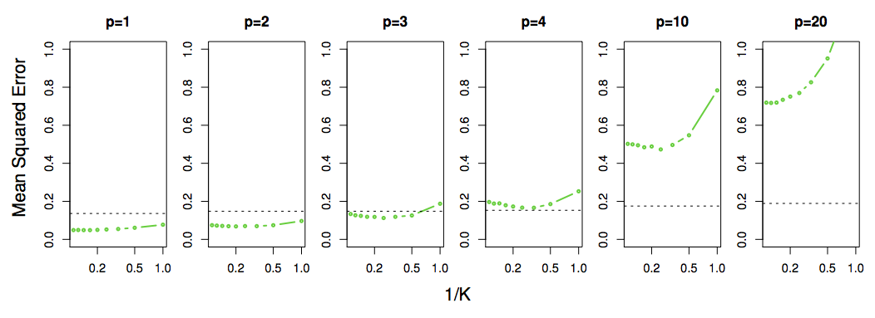
Not So Good in High Dimensional Situations

