Slide 1
What is Statistical Learning?
Chapter 02 – Part I

Slide 2
Outline
What Is Statistical Learning?
  Why estimate f?
  How do we estimate f?
  The trade-off between prediction accuracy and model interpretability
  Supervised vs. unsupervised learning
  Regression vs. classification problems

Slide 3

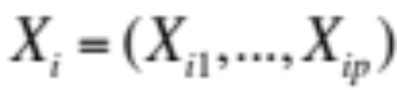

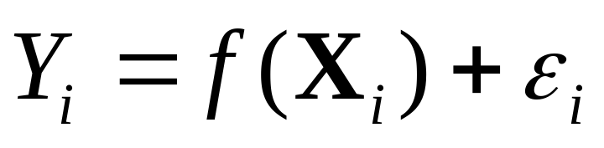
What is Statistical Learning?
Suppose we observe and for
We believe that there is a relationship between Y and at least one of the X’s.
We can model the relationship as
Where f is an unknown function and ε is a random error with mean zero.

Slide 4
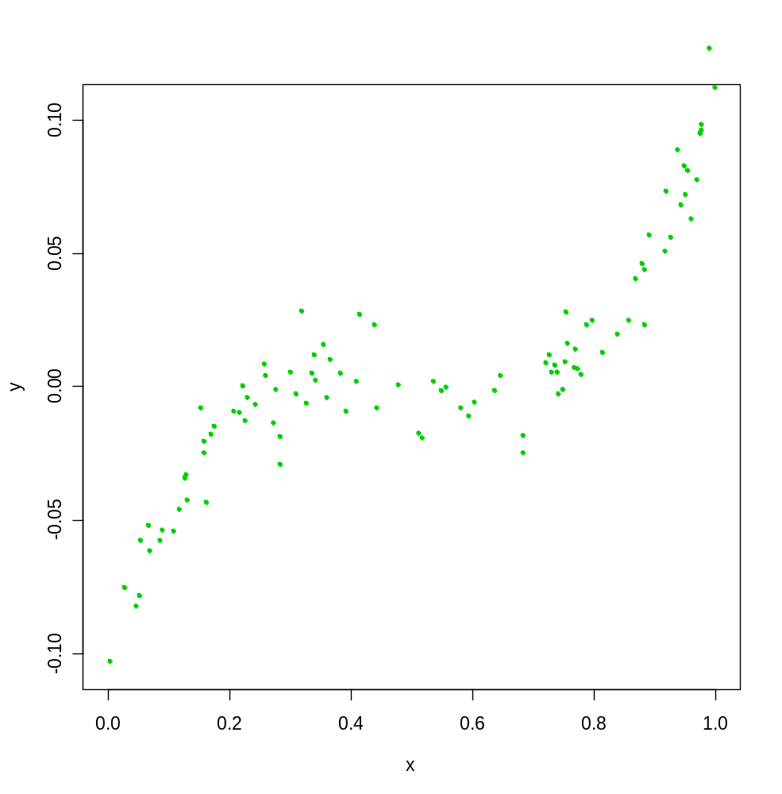
A Simple Example

Slide 5
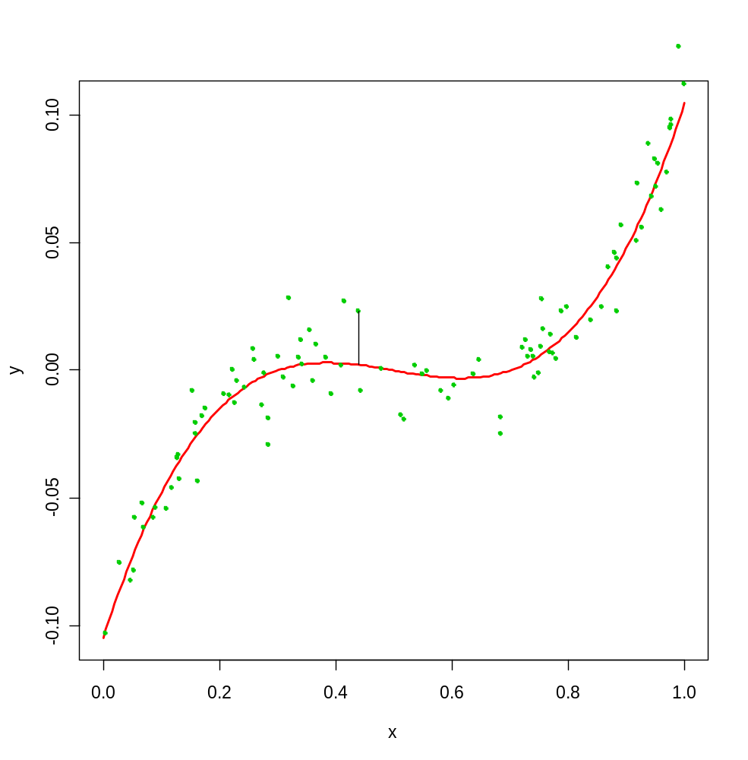
A Simple Example
ε_{i}
f

Slide 6
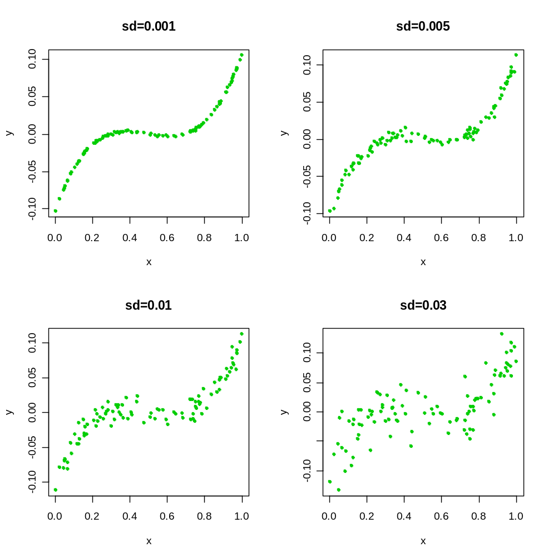
Different Standard Deviations
The difficulty of estimating f will depend on the standard deviation of the ε’s.

Slide 7
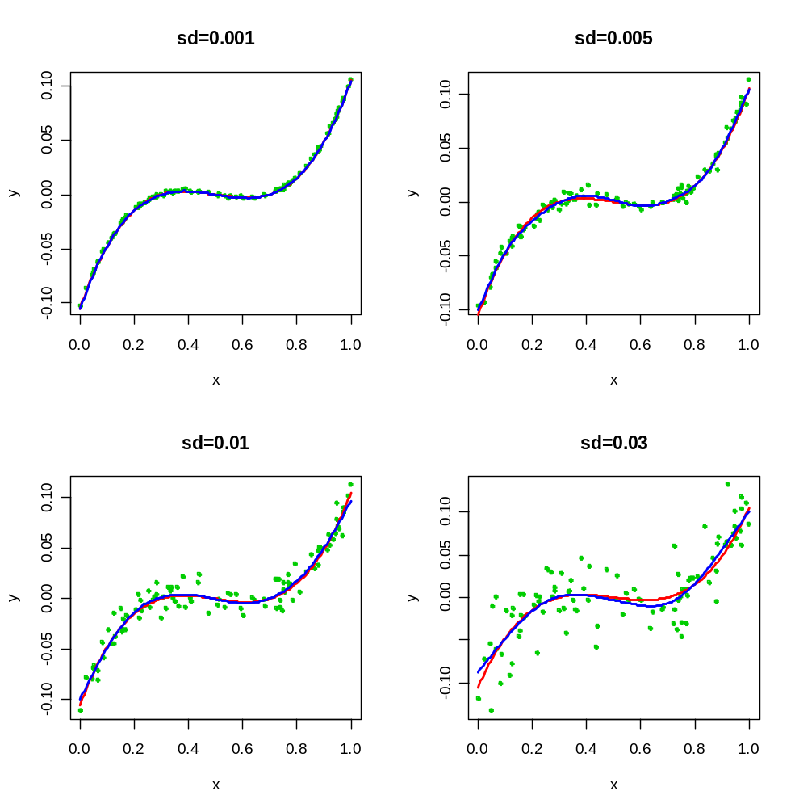
Different Estimates For f

Slide 8
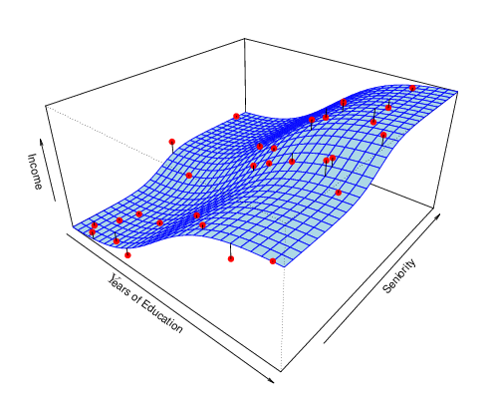
Income vs. Education Seniority

Slide 9
Why Do We Estimate f?
Statistical Learning, and this course, are all about how to estimate f.
The term statistical learning refers to using the data to “learn” f.
Why do we care about estimating f?
There are 2 reasons for estimating f,
  Prediction and
  Inference.

Slide 10
1. Prediction
If we can produce a good estimate for f (and the variance of ε is not too large) we can make accurate predictions for the response, Y, based on a new value of X.

Slide 11
Example: Direct Mailing Prediction
Interested in predicting how much money an individual will donate based on observations from 90,000 people on which we have recorded over 400 different characteristics.
Don’t care too much about each individual characteristic.
Just want to know: For a given individual should I send out a mailing?

Slide 12
2. Inference
Alternatively, we may also be interested in the type of relationship between Y and the X's.
For example,
  Which particular predictors actually affect the response?
  Is the relationship positive or negative?
  Is the relationship a simple linear one or is it more complicated etc.?

Slide 13
Example: Housing Inference
Wish to predict median house price based on 14 variables.
Probably want to understand which factors have the biggest effect on the response and how big the effect is.
For example how much impact does a river view have on the house value etc.

Slide 14
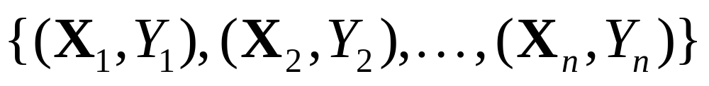
How Do We Estimate f?
We will assume we have observed a set of training data
We must then use the training data and a statistical method to estimate f.
Statistical Learning Methods:
  Parametric Methods
  Non-parametric Methods

Slide 15
Parametric Methods
It reduces the problem of estimating f down to one of estimating a set of parameters.
They involve a two-step model based approach
  STEP 1:
  Make some assumption about the functional form of f, i.e. come up with a model. The most common example is a linear model i.e.
However, in this course we will examine far more complicated, and flexible, models for f. In a sense the more flexible the model the more realistic it is.

Slide 16
Parametric Methods (cont.)
STEP 2:
Use the training data to fit the model i.e. estimate f or equivalently the unknown parameters such as β₀, β₁, β₂,…, β_{p}.
    The most common approach for estimating the parameters in a linear model is ordinary least squares (OLS).
    However, this is only one way.
    We will see in the course that there are often superior approaches.

Slide 17
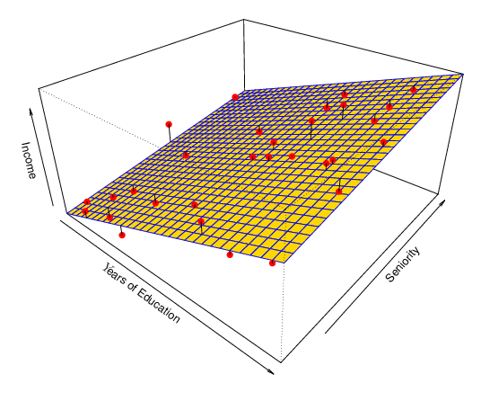
Example: A Linear Regression Estimate
Even if the standard deviation is low we will still get a bad answer if we use the wrong model.

Slide 18
Non-parametric Methods
They do not make explicit assumptions about the functional form of f.
Advantages: They accurately fit a wider range of possible shapes of f.
Disadvantages: A very large number of observations is required to obtain an accurate estimate of f

Slide 19
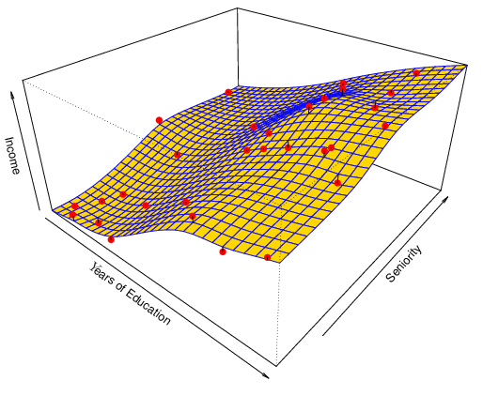
Example: A Thin-Plate Spline Estimate
Non-linear regression methods are more flexible and can potentially provide more accurate estimates.

Slide 20
Tradeoff Between Prediction Accuracy and Model Interpretability
Why not just use a more flexible method if it is more realistic?
There are two reasons
Reason 1:
A simple method such as linear regression produces a model which is much easier to interpret (the Inference part is better). For example, in a linear model, β_{j} is the average increase in Y for a one unit increase in X_{j} holding all other variables constant.

Slide 21
  Reason 2:
  Even if you are only interested in prediction, so the first reason is not relevant, it is often possible to get more accurate predictions with a simple, instead of a complicated, model. This seems counter intuitive but has to do with the fact that it is harder to fit a more flexible model.

Slide 22
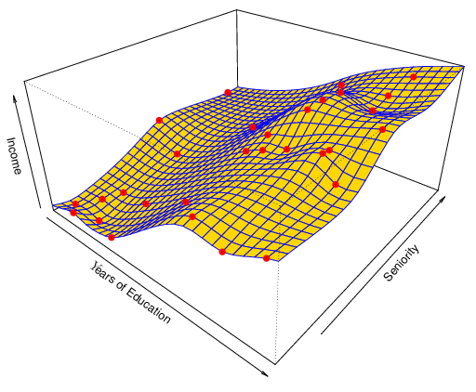
A Poor Estimate
Non-linear regression methods can also be too flexible and produce poor estimates for f.

Slide 23
Supervised vs. Unsupervised Learning
We can divide all learning problems into Supervised and Unsupervised situations
Supervised Learning:
  Supervised Learning is where both the predictors, X_{i}, and the response, Y_{i}, are observed.
  This is the situation you deal with in Linear Regression classes (e.g. GSBA 524).
  Most of this course will also deal with supervised learning.

Slide 24
Unsupervised Learning:
  In this situation only the X_{i}’s are observed.
  We need to use the X_{i}’s to guess what Y would have been and build a model from there.
  A common example is market segmentation where we try to divide potential customers into groups based on their characteristics.
  A common approach is clustering.
  We will consider unsupervised learning at the end of this course.

Slide 25
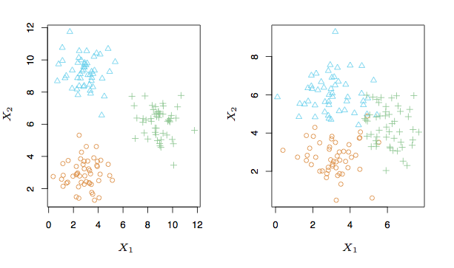
A Simple Clustering Example

Slide 26
Regression vs. Classification
Supervised learning problems can be further divided into regression and classification problems.
Regression covers situations where Y is continuous/numerical. e.g.
  Predicting the value of the Dow in 6 months.
  Predicting the value of a given house based on various inputs.
Classification covers situations where Y is categorical e.g.
  Will the Dow be up (U) or down (D) in 6 months?
  Is this email a SPAM or not?

Slide 27
Different Approaches
We will deal with both types of problems in this course.
Some methods work well on both types of problem e.g. Neural Networks
Other methods work best on Regression, e.g. Linear Regression, or on Classification, e.g. k-Nearest Neighbors.

